Slide 1

Where Youth Culture, Brands, Education, Entertainment & Experience Converge
The first national experiential expo platform built to connect brands directly with the next generation of consumers.
Robert Keegan
Founder & Managing Director
American Teen Scene Expo™
bob@k27group.com www.americanteenscene.com630-730-5992
Lake Worth, Florida

Slide 2
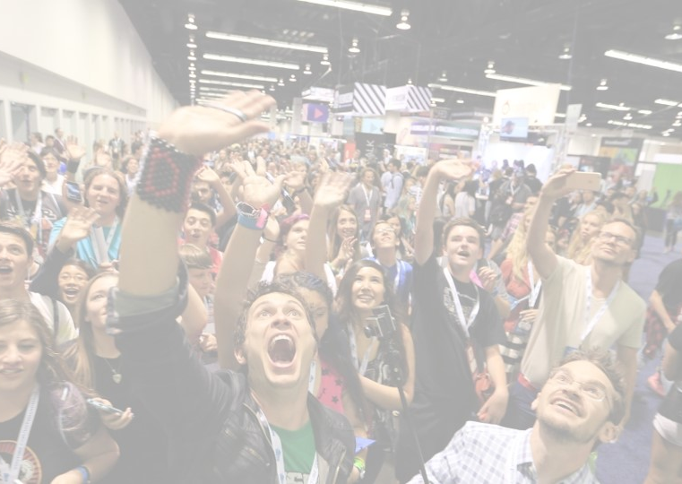
“An Experiential Event Where Brands Meet the Next Generation”
The American Teen Scene Expo™:
Built exclusively for teenagers aged 13 to 19+
A dynamic Five-City, three-day event, Friday through Sunday.
Houston, TX, Indianapolis, IN, Washington, DC, Phoenix, AZ, Detroit, MI (subject to change)
Each expo will feature 300+ leading consumer products and service brands
One-of-a-kind environment that blends education, career exploration, and interactive engagement.
Offers a powerful platform where teens can discover new products, explore career opportunities, and connect directly with brands in a fun, immersive, and face-to-face setting
Making it an essential destination for companies seeking to build meaningful relationships with the next generation of consumers.
“American Teen Scene Expo™ experiential event is being built to become the national live platform where brands, education, entertainment, technology, and youth culture come together under one roof.”

Slide 3
The Problem
Brands Are Struggling to Reach Gen Z and Emerging Gen Alpha in Authentic, High-Engagement Environments
Teen consumers influence hundreds of billions of dollars in annual household and personal spending, yet brands lack a centralized, experiential platform dedicated to engaging them directly, safely, and at scale.
Traditional marketing channels are becoming less effective:
Social media advertising is saturated and increasingly ignored
Digital customer acquisition costs continue to rise
Teen audiences are fragmented across platforms, creators, gaming, streaming, and micro-communities
Retail foot traffic among younger consumers continues shifting toward experiences rather than traditional shopping environments
At the same time, parents, educators, and brands are seeking trusted environments where teens can discover products, trends, education, entertainment, technology, career pathways, and lifestyle experiences in person.

Slide 4

Market Insight & Vision
A Massive Shift in Youth Engagement Is Reshaping Consumer Marketing
And No National Platform Currently Owns This Space
Consumer behavior has fundamentally changed.
Gen Z and emerging Gen Alpha no longer engage with brands through traditional advertising alone. They engage through:
Experiences
Influencers
Community
Live interaction
Social sharing
Discovery-driven environments
At the same time, brands are shifting billions of dollars toward experiential marketing because digital advertising is becoming:
More expensive
Less trusted
Less effective
Harder to target

Slide 5
Who Feels the Pain?
Consumer Brands
Fashion, beauty, technology, gaming, entertainment, sports, food, wellness, automotive, education, and lifestyle brands struggle to:
Build authentic loyalty with younger consumers
Generate experiential engagement
Capture first-party consumer data
Launch products directly to youth audiences
Create measurable in-person brand experiences
Advertisers & Sponsors
Sponsors need high-visibility experiential platforms that combine:
Live engagement
Influencer amplification
Social content creation
Data collection
Community activation
There are very few national-scale platforms focused specifically on the teen demographic.
Teens & Families
Teen consumers want:
Interactive experiences
Discovery-driven entertainment
Creator and influencer access
Community
Career inspiration
Live events built specifically for their generation
Today, no dominant national expo brand fully owns this space.

Slide 6
Why Now?
Multiple Market Trends Are Converging
Experiential Marketing Is Surging
Brands are reallocating budgets toward live experiences because consumers increasingly value participation over passive advertising.
Gen Z Spending Power Is Massive
Gen Z and emerging Gen Alpha are shaping purchasing trends in:
Fashion
Gaming
Beauty
Consumer technology
Entertainment
Food & beverage
Social commerce
Brands Need First-Party Consumer Relationships
As digital privacy rules tighten and ad targeting becomes more difficult, brands are actively seeking direct engagement channels.
Youth Culture Is Driving Mainstream Consumer Trends
Teen-driven social trends now influence national purchasing behavior faster than traditional advertising channels.
There Is No National Market Leader
Despite the size of the opportunity, there is currently no scaled, recurring, business-to-consumer expo platform dedicated exclusively to the American teen market.

Slide 7
What’s Changing in the Market?
The Shift
FROM:
Passive advertising
Traditional retail marketing
One-way brand messaging
Fragmented digital impressions
TO:
Live immersive experiences
Creator-driven engagement
Interactive product discovery
Community participation
Social-content generation
First-party consumer relationships
Why This Creates Opportunity
Despite the size of the youth market:
No dominant national teen-focused expo exists
Brands lack a centralized youth engagement platform
Experiential marketing demand is accelerating
Youth culture increasingly drives mainstream purchasing trends
This creates a major whitespace opportunity for a scalable national event platform.

Slide 8
The Vision
American Teen Scene Expo™
To become the premier national experiential platform connecting brands, entertainment, technology, creators, and youth culture.
The expo is designed to combine:
Consumer discovery
Entertainment
Social amplification
Influencer engagement
Brand activations
Community experiences
Live commerce
Youth-focused lifestyle experiences
Under one scalable event ecosystem.

Slide 9
Why We’re Built to Win
The American Teen Scene Expo is intentionally designed around modern consumer behavior:
Experience First
Immersive activations instead of passive booths
Social Amplification
Built for shareable content and creator engagement
Multi-Industry Appeal
Fashion, gaming, beauty, tech, sports, entertainment, education, wellness, food & beverage
Sponsor-Friendly Architecture
Designed for measurable engagement and brand integration
Scalable Event Model
Expandable nationally through recurring expos, sponsorships, digital extensions, and media partnerships

Slide 10
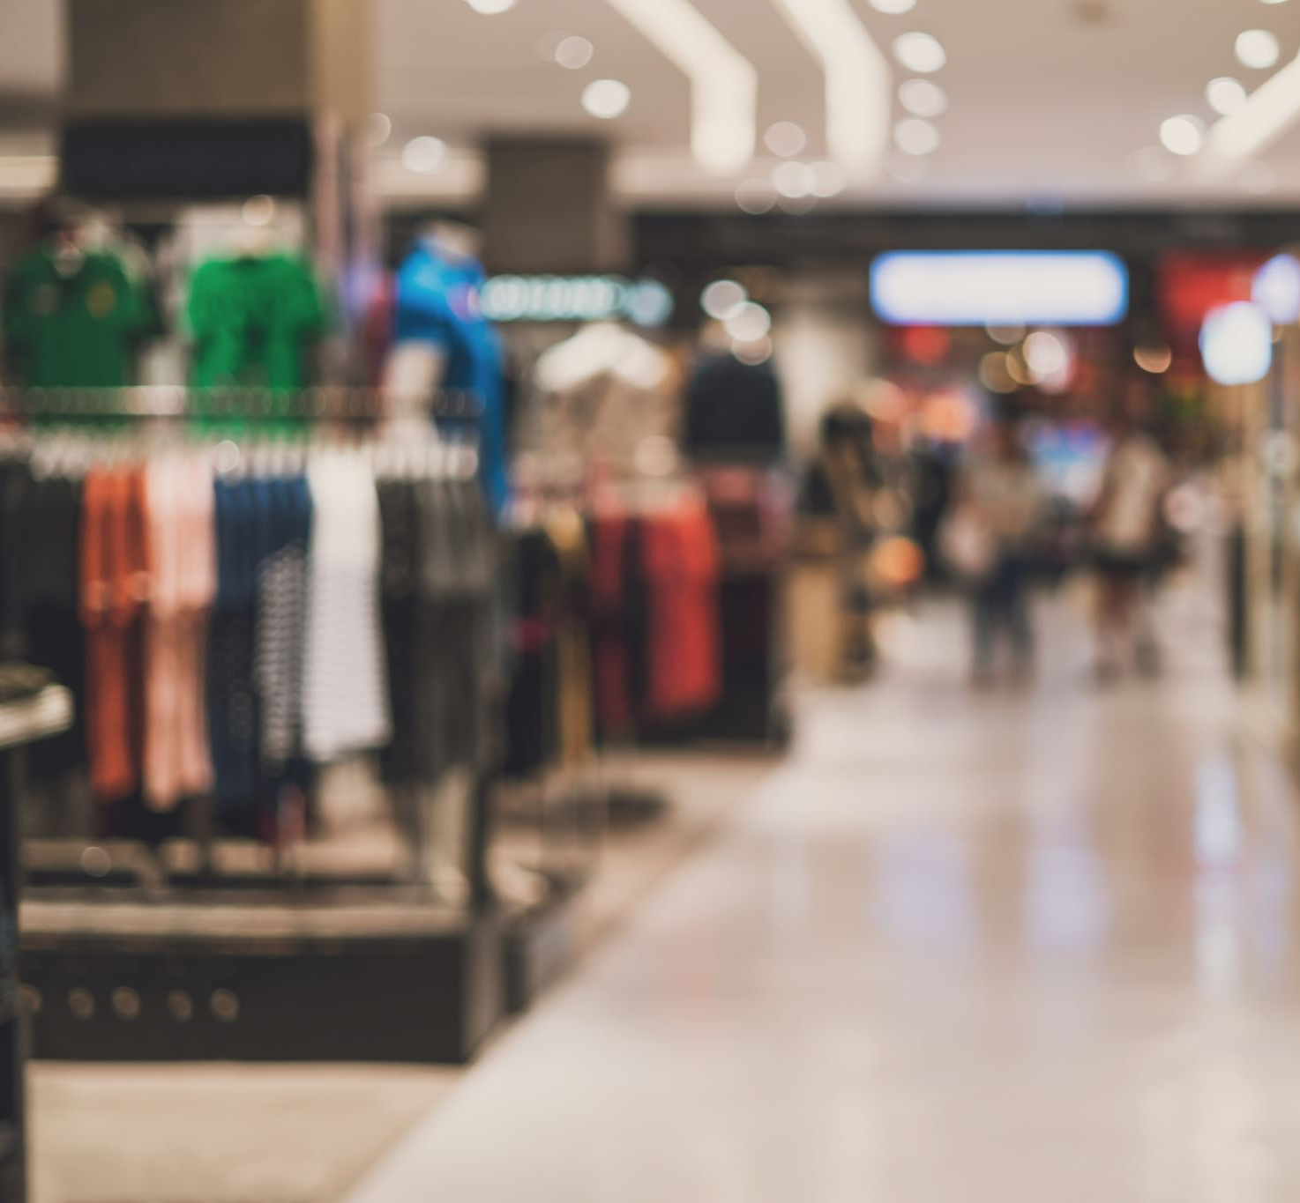
The American Teen Scene Expo is being built to solve a growing disconnect between brands seeking authentic youth engagement and teen consumers seeking experiential, community-driven discovery platforms.
Brands are spending billions trying to reach Gen Z consumers through fragmented digital channels, yet there is no dominant national experiential platform dedicated to teen engagement. The American Teen Scene Expo is designed to fill that gap.

Slide 11
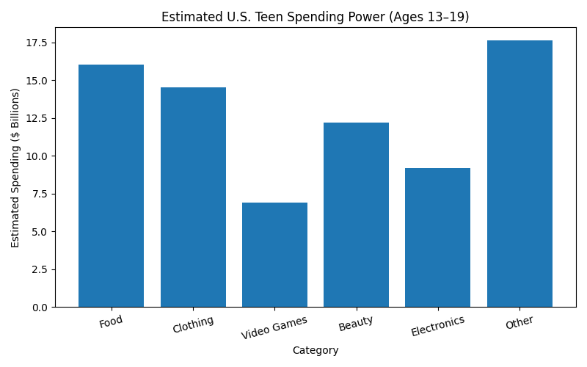
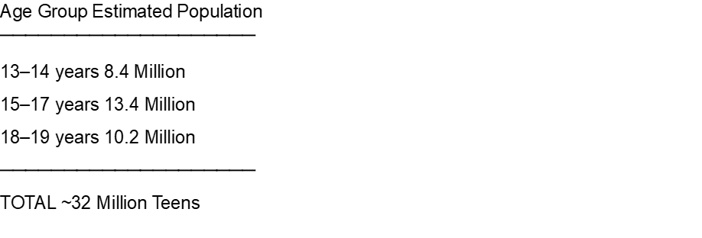
Market Size & Timing
A Multi-Billion Dollar Market Opportunity Driven by Youth Culture and Experiential Marketing

Slide 12
Market Opportunity
The American Teen Scene Expo™ sits at the intersection of several rapidly growing industries:
Experiential Marketing
Global experiential marketing spending continues to accelerate as brands shift away from traditional advertising toward immersive consumer engagement.
Youth Consumer Spending
Gen Z and emerging Gen Alpha influence hundreds of billions in direct and household purchasing decisions annually across:
Fashion
Beauty
Gaming
Technology
Food & beverage
Entertainment
Sports
Lifestyle products
Live Events & Consumer Expos
Consumers increasingly prioritize experiences, events, festivals, and interactive environments over passive retail engagement.

Slide 13

Total Addressable Opportunity
Potential Revenue Categories Include:
Sponsorship sales
Exhibitor booth sales
Ticketing
VIP experiences
Brand activations
Influencer partnerships
Merchandise
Licensing
Digital media extensions
Streaming/content rights
National tour expansion
The opportunity is larger than a single event.
American Teen Scene Expo™ is designed as a scalable youth engagement platform capable of evolving into:
A multi-city national event series (5 events years 1, 2, 3 / 10 events years 4, 5, 6,7, 8….)
International event series
A media property
A sponsorship ecosystem
A youth culture brand
A year-round consumer engagement platform

Slide 14
Product / Solution Overview
The American Teen Scene Expo™
A National Experiential Platform Connecting Brands Directly with the Next Generation
What We’re Building
American Teen Scene Expo™ is a large-scale live consumer event platform designed specifically for teen and youth culture engagement.
The expo combines:
Interactive brand activations
Entertainment experiences
Gaming & technology
Fashion & beauty
Music & creators
Sports & lifestyle
Education & career pathways
Social-content environments
Into one immersive, high-energy destination experience.

Slide 15
How It Works
Brands + Experiences + Community Brands
Participate through:
Experiential booths
Product launches
Sampling
Sponsorships
Creator collaborations
Live demonstrations
Social activations
Attendees
Experience:
Hands-on discovery
Entertainment
Influencer interaction
Interactive competitions
Product testing
Live performances
Community engagement
Digital Amplification
The event is designed to generate:
Social sharing
Influencer content
User-generated media
Brand engagement data
First-party consumer relationships
How We Solve the Problem For Brands
We provide:
Direct access to youth consumers
Authentic engagement opportunities
Measurable experiential marketing
Real-time product feedback
High-visibility sponsorship integration
Content-generation environments
Instead of relying only on fragmented digital advertising

Slide 16
For Teens & Families
We create:
A safe, exciting, discovery-driven environment
Experiences built specifically for their generation
Access to trends, entertainment, technology, and career opportunities
Community participation and live interaction
Why It Produces Results
The Expo Is Built Around Modern Consumer Behavior
Experience-Driven
Young consumers engage more deeply through participation than passive advertising.
Social-First Design
Every activation is designed to encourage content sharing and organic exposure.
Multi-Industry Ecosystem
The platform brings together multiple youth-driven industries under one roof.
Scalable Sponsorship Model
Brands can activate locally, regionally, or nationally across future events and expansions.
What Makes It Different
American Teen Scene Expo™ is not:
A traditional trade show
A simple fan convention
A music festival
A mall-style expo
It is:
A hybrid experiential marketplace built around youth culture, entertainment, technology, and brand engagement.
Surrounding categories:
Fashion
Gaming
Beauty
Technology
Music
Sports
Education
Food & Beverage
Influencers
Entertainment
“The future of brand engagement is immersive, social, and experience-driven.”

Slide 17
Go-To-Market Strategy
Building a National Youth Engagement Platform Through Strategic Brand, Influencer & Community Growth
Go-To-Market Approach
American Teen Scene Expo™ is designed to scale through a multi-channel growth strategy that combines:
Strategic sponsorship sales
Influencer amplification
Social-media-driven audience growth
Community partnerships
School and youth outreach
Entertainment-driven marketing
Experiential brand engagement
Phase 1 — Launch & Market Validation
Initial Focus:
Establish the inaugural five city flagship events and validate:
Sponsor demand
Consumer attendance
Brand engagement
Influencer participation
Social reach
Revenue model performance
Early Target Customers:
Consumer brands targeting Gen Z
Youth-focused lifestyle companies
Gaming & technology brands
Fashion & beauty companies
Entertainment & streaming platforms
Food & beverage brands
Educational and career organizations

Slide 18
Partnerships with:
Schools (Friday’s are Field Trip Day)
Youth organizations
Community groups
Sports programs
Entertainment networks
Experiential Hype Building Pre-event:
Pop-up activations
Social contests
Creator appearances
Digital countdown campaigns
Brand teaser content
Sponsor & Exhibitor Sales Strategy
We target brands already investing in youth marketing and experiential campaigns.
Sales Channels:
Direct sponsorship outreach
Agency partnerships
Brand marketing departments
Entertainment partnerships
Experiential marketing agencies
Strategic media relationships
Audience Acquisition Strategy
We Grow Through Culture-Driven Marketing
Social Media Campaigns
High-frequency content across:
TikTok
Instagram
YouTube
Snapchat
Emerging creator platforms
Influencer & Creator Partnerships
Collaborations with:
Content creators
Musicians
Athletes
Gaming personalities
Lifestyle influencers
Community Outreach

Slide 19
What’s Already Working
Early Indicators of Demand
Strong interest from youth-focused brands
Positive market feedback on the concept
Rising experiential marketing budgets
Growth of creator-led consumer engagement
Increasing demand for live activation opportunities
If you already have: (Should we add this?
conversations,
letters of interest,
advisors,
social traction,
venue discussions,
influencer discussions,
“We are building both an event audience and a long-term cultural brand.”
Scalability Strategy
The model is designed to expand predictably through:
Recurring Annual Events
Building audience loyalty and sponsor retention
Multi-City Expansion
Launching additional regional events
Sponsorship Ecosystem Growth
Increasing national and international brand partnerships
Digital Extensions
Streaming, media content, creator integrations, and online community engagement
Licensing & Strategic Partnerships
Potential expansion into affiliated youth-focused event properties
Why This Growth Model Works
The platform benefits from network effects:
More brands → attract more attendees
More attendees → attract more sponsors
More creators → increase social reach
More social reach → lower customer acquisition costs
This creates compounding growth potential over time.

Slide 20
Business Model & Unit Economics
A Diversified Revenue Model Built for Scalable Growth
How American Teen Scene Expo™ Makes Money
The business is designed around multiple recurring revenue streams that scale as attendance, sponsorship demand, and brand visibility increase
Primary Revenue Streams Sponsorship Revenue
The Core Revenue Driver Brands pay for:
Title sponsorships
Category exclusivity
Experiential activations
Naming rights
Stage sponsorships
Music & Fashion Challenges
Creator collaborations
Social-media integrations
High-margin recurring opportunity
Direct Sales (Cash & Carry)
Exhibitor Booth Sales
Companies purchase:
Booth space
Premium floor placement
Interactive activation zones
Product launch areas
Sampling experiences
Revenue scales with event size and exhibitor demand.
Ticket Sales
Consumer revenue from:
General admission
VIP experiences
Early-access passes
Meet-and-greet experiences
Premium entertainment access

Slide 21
Digital & Media Revenue
Future expansion opportunities include:
Streaming partnerships
Creator content monetization
Digital sponsorships
Social campaigns
Event media licensing
Online community memberships
Merchandise & Licensing
Additional revenue opportunities:
Branded merchandise
Exclusive collaborations
Apparel partnerships
Licensing opportunities
Co-branded products
Affiliate Marketing
Unit Economics
Revenue Scales Faster Than Fixed Costs
As attendance and sponsorship demand grow:
Venue and production costs become more efficient per attendee
Sponsor revenue expands disproportionately
Repeat sponsors reduce customer acquisition costs
Social amplification lowers marketing expense over time
This creates improving margins as the platform matures.
Economic Engine
Example Growth Dynamic
More attendees →
Higher sponsor visibility →
More sponsor demand →
Higher sponsorship pricing →
Greater profitability
At scale, sponsorship and media revenue become the primary margin expansion drivers.

Slide 22
Why the Model Is Attractive
Multiple Revenue Layers
Not dependent on a single income stream
High Sponsor Value Potential
Brands increasingly seek measurable experiential engagement
Strong Repeat Potential
Annual events create recurring sponsor and attendee relationships
Scalable National & International Expansion
The operating model can extend into additional markets and event formats
Long-Term Business Vision
American Teen Scene Expo™ is designed to evolve beyond a five-city event into:
A national and international event platform
A youth marketing ecosystem
A sponsorship and media property
A year-round consumer engagement brand
“Built for recurring revenue, sponsor retention, and national & international expansion.”
“As the audience grows, brand value and sponsor demand compound.”

Slide 23
Sample Floor Plan

Slide 24
Traction & Proof Points
Early Momentum Demonstrates Market Interest and Category Potential
What We’ve Proven So Far
American Teen Scene Expo™ has already generated early market validation through industry conversations, strategic development, and growing interest around the concept.
This is not being built in a vacuum — it is being developed in response to clear shifts in youth engagement and experiential marketing demand.
Current Proof Points
Market Validation
Positive feedback from industry discussions
Strong conceptual interest from youth-focused brands and partners
Growing demand for experiential marketing platforms targeting Gen Z
Strategic Development
Business structure and positioning established
Investor outreach and funding discussions underway
Sponsorship and partnership strategy in development
Scalable national event framework created
Industry Timing
The market is actively moving toward:
Live consumer engagement
Influencer-driven marketing
Experience-first activations
Community-centered brand interaction
American Teen Scene Expo™ is positioned directly within these accelerating trends.

Slide 25
What Early Success Looks Like
(We will customize this section as real metrics develop.)
Potential Near-Term Milestones:
Sponsor LOIs (Letters of Intent)
Brand partnership discussions
Venue negotiations
Influencer participation commitments
Social audience growth
Advisory board recruitment
Media interest
Vendor onboarding
Ticket waitlist growth
Future KPI Categories
Investors will ultimately track:
Sponsor acquisition
Exhibitor retention
Ticket sales velocity
Social engagement reach
Influencer impressions
Consumer attendance growth
Brand renewal rates
Revenue per attendee
Cost per attendee acquisition
Why Traction Matters
We are validating both sides of the marketplace:
Brands Want:
Authentic youth engagement
Experiential visibility
Social amplification
First-party consumer interaction

Slide 26
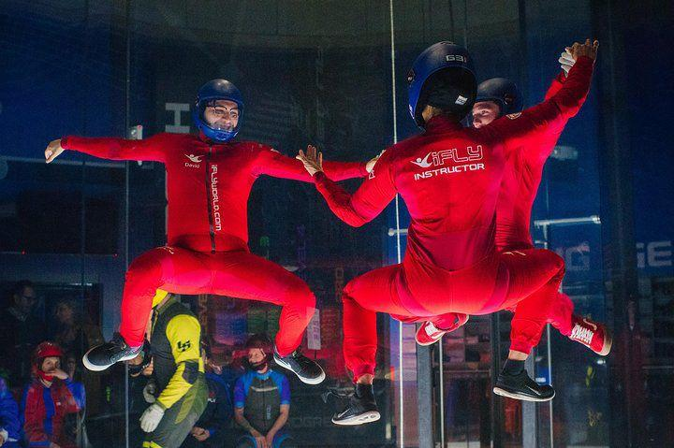
Consumers Want:
Live experiences
Community
Creator interaction
Discovery-driven entertainment
The platform is designed where those interests intersect.
Strategic Advantage
Timing + Market Gap + Cultural Relevance
The absence of a dominant national teen experiential platform creates an opportunity to establish:
Early brand relationships
Sponsor loyalty
Audience community
Cultural relevance
Long-term category leadership
“We are building momentum in a market already moving in our direction.”
“The demand signals are already visible — the opportunity now is execution at scale.”

Slide 27
Leadership Team
Experienced Leadership Positioned to Build a Category-Defining Youth Engagement Platform
Leadership Vision
American Teen Scene Expo™ is being led by a team focused on building more than an event — the goal is to create a scalable national youth culture and experiential marketing platform.
The leadership strategy combines:
Trade show expertise – Domestic & International
Brand partnership development
Experiential marketing vision
Strategic business development
Consumer engagement understanding
Operational execution

Slide 28
Founder & Managing Director
Robert Keegan
Event Industry Executive | Trade Show Strategist | Sponsorship & Operations Leader
Robert Keegan brings more than 40 years of experience in trade shows, corporate events, live entertainment, sponsorship development, and operational leadership. He has successfully led domestic and international trade show programs, launched event brands, secured funding, negotiated strategic partnerships, and managed multimillion-dollar operations.
Key leadership highlights:
Managed and executed corporate events, conferences, trade shows, user conferences, roadshows, and live entertainment productions.
Developed integrated sponsorship and revenue-generation programs.
Launched and scaled new event properties from concept through execution.
Secured first-round funding and licensing agreements for international trade show expansion.
Directed trade show teams, vendors, stakeholders, and operational logistics across multiple industries.
Managed budgets, P&L responsibilities, and event ROI analysis.
Deep expertise in marketing strategy, digital acquisition, attendee engagement, and brand positioning.
Extensive experience in venue negotiations, convention services, exhibit design, and event technology platforms.

Slide 29
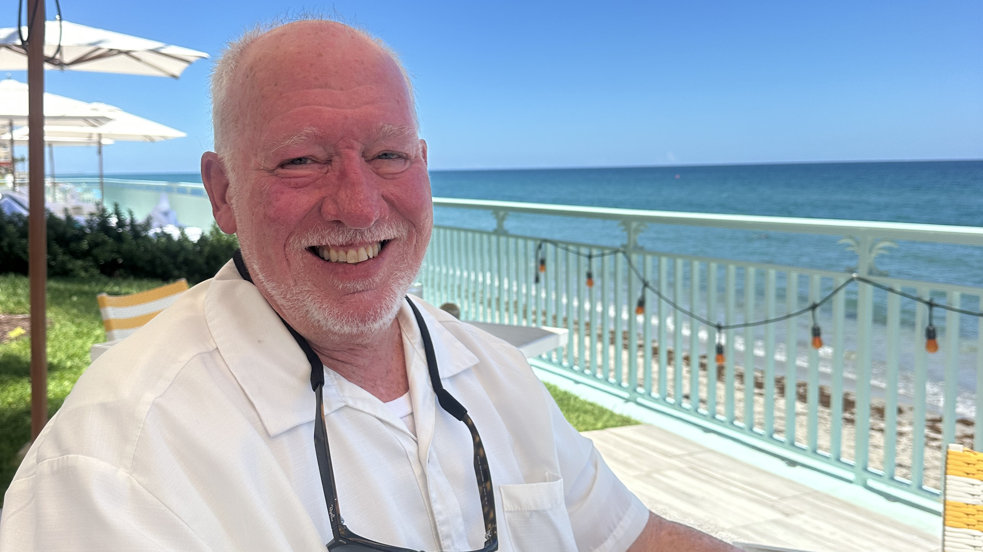
Past leadership experience includes:
Founder/Trade Show Manager — K27 Group, LLC
Founder-CEO — EQU Expo, Inc.
Project Manager Consultant — Reed Exhibitions
Vice President U.S. Division — FEELINI Holding GmbH
Trade Show Manager — TGIFCon
Founder/Production/Road Manager — RobKee Productions, LLC Live Entertainment Industry
United States Air Force Veteran
Core competencies
Strategic leadership
Sponsorship development
Event operations
Revenue growth
Marketing and branding
Team building
Budget management
Global event execution

Slide 30
Planned Executive Leadership Team (Growth Stage)
Chief Operating Officer (COO)
Responsibility
Oversees daily operations
Event production and logistics
Vendor and venue management
Staffing and operational scalability
Chief Marketing Officer (CMO)Responsibility
Teen audience acquisition strategy
Digital marketing campaigns
Social media and influencer partnerships
Brand development and consumer engagement
Chief Revenue Officer (CRO)
Responsibility
Sponsorship sales
Brand partnerships
Exhibitor recruitment
Revenue growth initiatives
Chief Technology & Innovation Officer (CTO)
Responsibility
AI integration
Mobile app and attendee experience platforms
Data analytics
Digital engagement systems
Director of Teen Programming & Community Engagement
Responsibility
Teen-focused content and experiences
Creator and influencer relationships
School and youth organization partnerships
Trend identification and audience insights
Chief Financial Officer (CFO)
Responsibility
Financial planning
Investor reporting
Capital management
Forecasting and compliance

Slide 31
Why This Team Is Built to Execute
The American Teen Scene Expo combines experienced event-industry leadership with a scalable growth structure designed for sponsorship, operations, technology, and youth engagement. The organization is being built with both traditional event-management expertise and modern consumer-brand strategies required to capture the Gen Z and emerging teen market.
Core Leadership Strengths
Industry Understanding
Deep familiarity with event production, exhibitor expectations, and sponsor activation strategy.
Relationship-Driven Development
Ability to build partnerships across:
Brands
Agencies
Entertainment
Influencers
Vendors
Strategic operators
Vision + Scalability
The company is being structured for long-term national & International expansion rather than a one-time event.

Slide 32
Advisory & Strategic Expansion
Planned Leadership Expansion Includes:
Sponsorship sales executives
Experiential marketing advisors
Entertainment partnerships
Digital/social media leadership
Operations and logistics specialists
Brand strategy advisors
Finance and corporate development leadership
Why This Team Can Execute
The Opportunity Requires More Than Event Production
Success depends on understanding:
Youth culture trends
Sponsor economics
Consumer engagement
Experiential marketing
Content amplification
Community building
Scalable operations
American Teen Scene Expo™ is being built with that broader ecosystem vision from day one.

Slide 33

Funding Ask & Growth Roadmap
Funding the Launch and National Expansion of American Teen Scene Expo™
*See Attached Pro-Forma
Capital Strategy
Seed Round — $2.5 Million
Current Raise
The seed investment funds:
Initial launch operations
Team buildout
Secure venues (Five)
Sponsorship development
Marketing and audience acquisition
Event production infrastructure
Technology systems
Brand positioning and market validation
Primary objective:
Successfully launch and validate the first year five-city inaugural American Teen Scene Expo™ flagship events.

Slide 34
Planned Growth Financing
Series / First Growth Round — $5 Million
Targeted Approximately 9 Months Following Seed Round
The next financing stage is designed to accelerate:
Multi-market expansion – Years 2, 3, 4, etc..
National sponsorship growth
Talent acquisition
Media and content development
Scaled audience acquisition
Strategic partnerships
Expanded operational infrastructure
Use of Seed Capital
Event Production & Operations
Venue and infrastructure
Production and staging
Staffing and logistics
Security and operations
Marketing & Audience Growth
Influencer campaigns
Social media marketing
PR and media outreach
Consumer acquisition campaigns
Sponsorship & Business Development
Brand partnerships
Exhibitor acquisition
Agency outreach
Sales infrastructure
Technology & Platform Infrastructure
Registration systems
CRM and sponsor analytics
Website and digital engagement tools
Media/content systems

Slide 35
What the Seed Round Unlocks
Key Milestones
Launch the first year five Inaugural Events
Deliver a premium flagship youth experiential platform.
Validate Market Demand
Demonstrate sponsor, exhibitor, and consumer engagement.
Establish Brand Credibility
Position American Teen Scene Expo™ as a national youth engagement property.
Build Strategic Partnerships
Secure foundational relationships across brands, creators, entertainment, and media.
Creating Expansion Readiness
Generate the operational and financial proof points needed for accelerated scaling.
9-Month Growth Objectives
By the Time of the $5M Growth Round:
Target outcomes include:
Successful first five city inaugural events execution
Established sponsor relationships
Growing consumer audience
Measurable social reach
Brand partnership pipeline
Expansion market strategy
Increased enterprise valuation
Long-Term Vision
American Teen Scene Expo™ is being built as:
A national experiential event platform
A youth culture media property
A scalable sponsorship ecosystem
A recurring consumer engagement brand

Slide 36
Timeline Layout
Phase 1
$2.5M Seed Round↓
Launch + Validation
Phase 2 (9 Months Later)
$5M Growth Round↓
Expansion + Multi-Year National Scale
Phase 3
Multi-City Platform Growth↓
Media + Sponsorship Ecosystem
Closing Statement
“The seed round establishes the platform. The growth round accelerates national scale.”
“Our financing strategy is designed to validate quickly, scale intelligently, and build long-term enterprise value.”
Important Note
This two-stage capital structure is attractive because it communicates:
Financial discipline
Milestone-based scaling
Reduced early dilution
Measurable validation before aggressive expansion
It signals that our company intends to scale based on traction, not just projections
*See Attached Pro-Forma & Business Plan

